Slide 1
Capstone Project
Global Terrorism Analysis
(Exploratory Data Analysis)
Team Members
Mandar Pate
Tejas Chaudhary
Shivam Jadhav
Pranav Gade

Slide 2
1) The Problem Statement 2) Data Exploration 3) Data Cleaning & Preprocessing 4) Data Analysis & Visualization 5) Challenges faced 6) Conclusion
Approach

Slide 3
Global Terrorism Database is the most comprehensive database of terrorist attacks in the world. This database provides information on the domestic and international terrorist attacks around the world since 1970 and includes more than 180,000 events. The idea of this project is to use the database and provide the most valuable insights about the terrorism and their groups in the world. To achieve our goal we have divided the analysis into three parts Terrorism on World level, Terrorism in India, Attacks and Damage done by the Terrorist groups.
Problem Statement

Slide 4
The dataset contains data of more than 180000 terrorist events happened since 1970 and has around 135 features describing each attack. Some of the key attributes consisting those features which are used for this project are listed below:
Data Exploration
Column Name | Description
iyear | Year of the Attack
imonth | Month of the attack
iday | Day of the attack
country_txt | Country on which Attack is executed
region_txt | Region of world on which Attack is Executed

Slide 5
Column Name | Description
provstate | Name of the State where attack was took placed (Categorical )
city | Name of the City where attack was took placed (Categorical )
attacktype1_txt | Preferred Attack types by Terrorist while Attacking (Categorical var)
targettype1_txt | Preferred Target types by Terrorist while Attacking (Categorical)
gname | Group name of terrorist who Attacked (Categorical)
weaptype1_txt | Weapon used by terrorists to attack (Categorical)
nkilled | Number of Deaths in attack (Numerical)
nwound | Number of Injured people in attack (Numerical)
success | 1: attack is successful , 0 : attack is unsuccessful

Slide 6
Data preprocessing is the first step to be done after collecting data. It is a set of operations performed on the dataset to modify ambiguous data which can be a bottleneck to analytical results. This data is often unorganized and contains a lot of information which is irrelevant to the project requirements. Data preprocessing methodology helps in converting this raw data into a more meaningful, focused, interpretable and readable format. Data cleaning is the process of fixing or removing incorrect, corrupted, incorrectly formatted, duplicate, or incomplete data within a dataset. In this Case We reduced the number of columns from 135 to 14 that results to reducing the missing values from 56% to 0.30% and Readable column names with Readable Dataset .
Data Preprocessing & Cleaning

Slide 7
Data preprocessing is the first step to be done after collecting data. It is a set of operations performed on the dataset to modify ambiguous data which can be a bottleneck to analytical results. This data is often unorganized and contains a lot of information which is irrelevant to the project requirements. Data preprocessing methodology helps in converting this raw data into a more meaningful, focused, interpretable and readable format. Data cleaning is the process of fixing or removing incorrect, corrupted, incorrectly formatted, duplicate, or incomplete data within a dataset. In this Case We reduced the number of columns from 135 to 14 that results to reducing the missing values from 56% to 0.30% and Readable column names with Readable Dataset .
Data Preprocessing & Cleaning

Slide 8
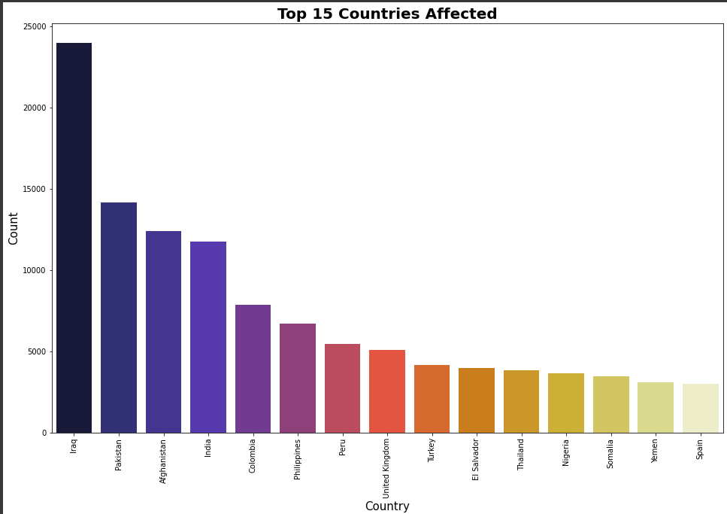
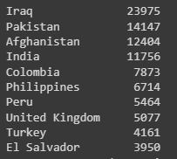
Countries with Highest Attacks
Iraq is the country that has the maximum number of attacks in the world followed by Pakistan between the years 1970 and 2017

Slide 9
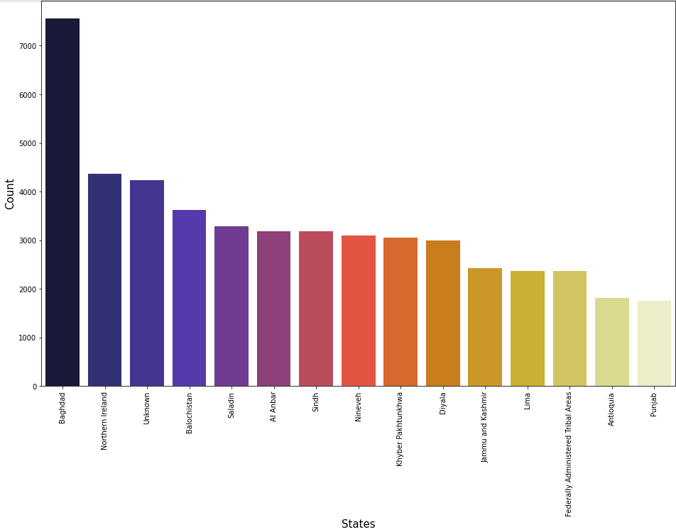
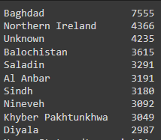
States with Highest Attacks
Baghdad is the State that has the maximum number of attacks in the world followed by Northern Ireland between the years 1970 and 2017

Slide 10
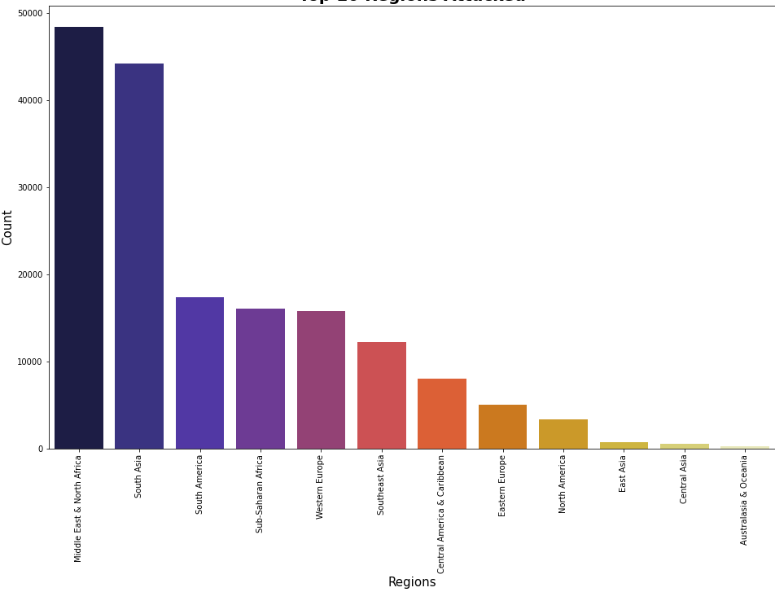
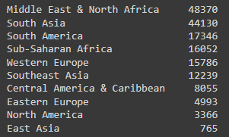
Regions with Highest Attacks
Middle East & North Africa is the Region that has the maximum number of attacks in the world followed by South Asia between the years 1970 and 2017

Slide 11
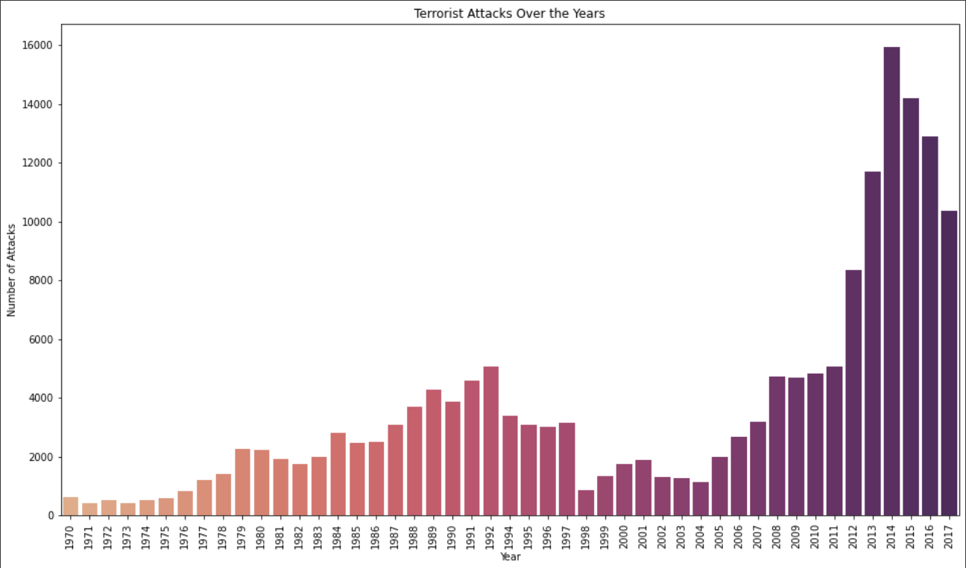
Increase in Terror Attacks
Year 2014 has recorded the utmost number of attacks near 16000 worldwide but , major increase in attack was from 2011 to 2012 i.e. 39%

Slide 12
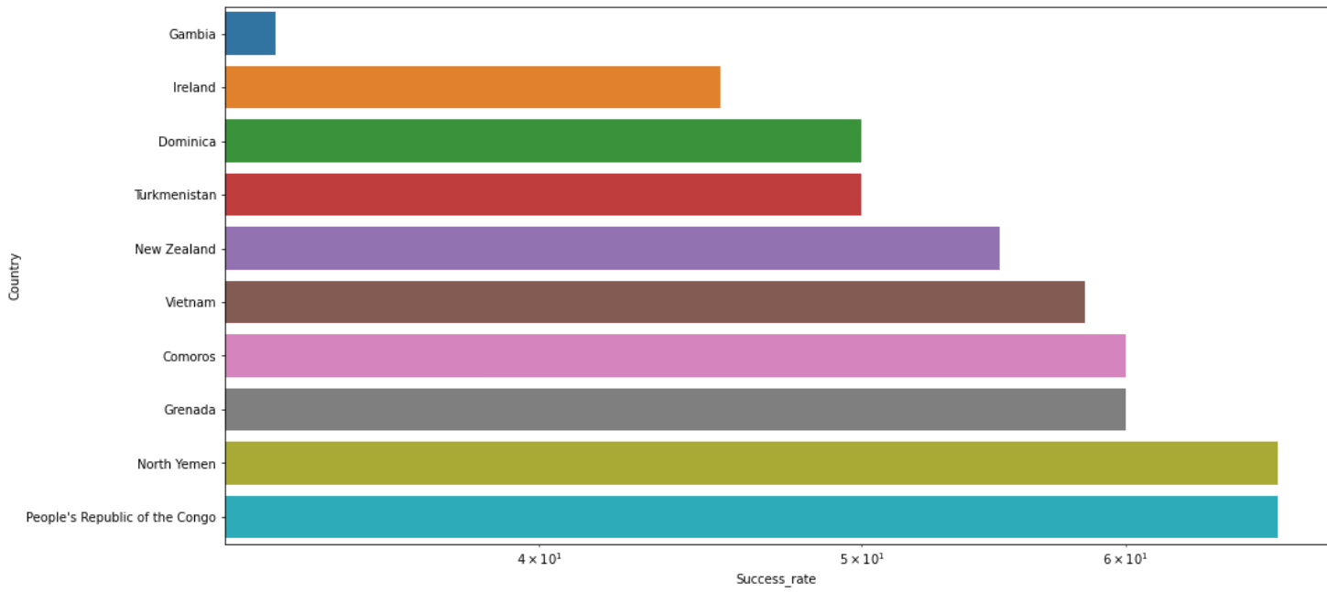
Success rate of Terrorist attacks
Terrorist has low success rate while attacking on Gambia , Ireland having 33% and 45% respectively

Slide 13
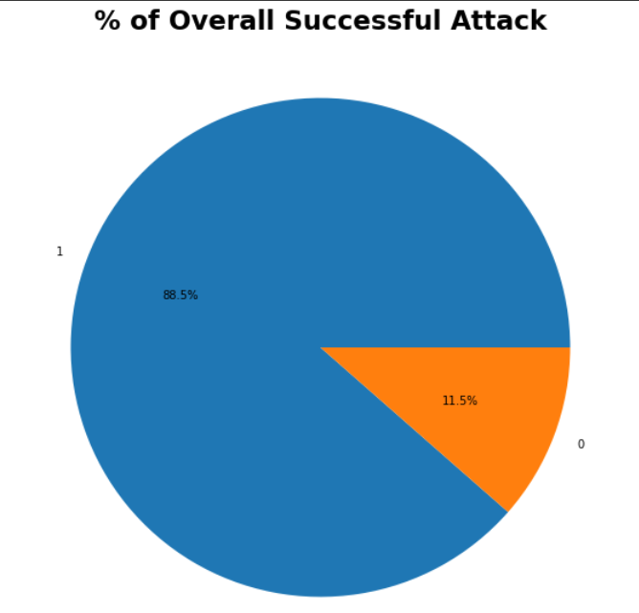
Martinique, Singapore, Seychelles, Solomon islands, Iceland , South Yemen , international, Botswana this countries are not that much good at Tackling Attacks as Compared to other Countries
Between 1970 to 2017 , nearly 88% of Terrorist Attacks were seen Successful.

Slide 14
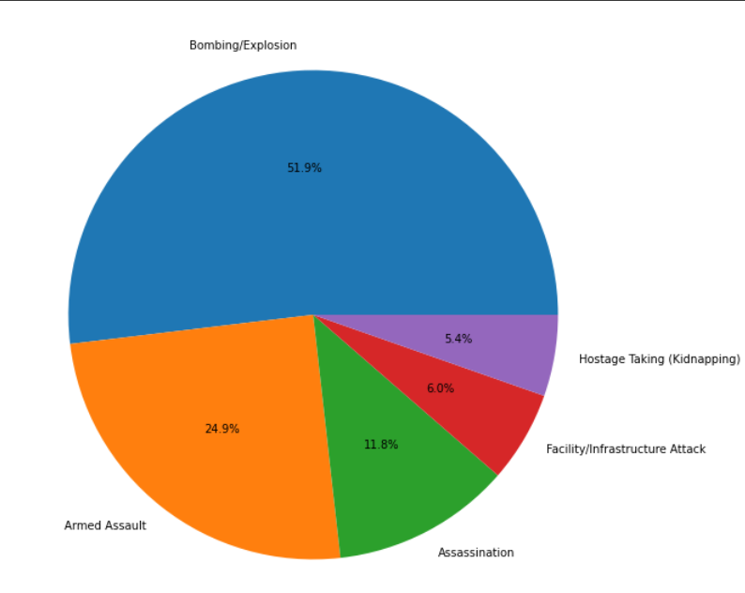
Attack Types
Terrorist mostly preferred attacking through ‘Bombing’ followed by ‘Armed Assault’ throughout the Years

Slide 15
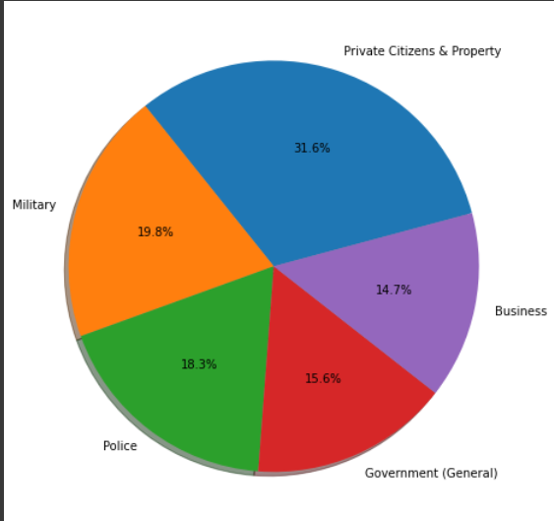
Target Types
Terrorist mostly Attacked on ‘Private Citizens & Property’ and ‘Military’, ‘Police’.
31.6% attacks

Slide 16
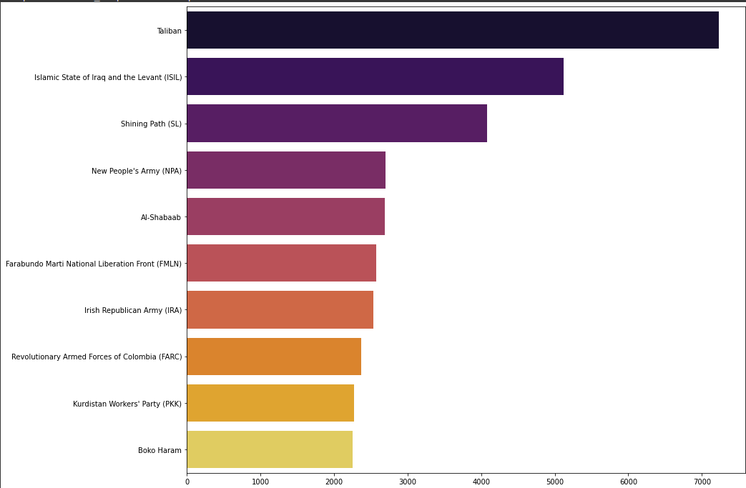
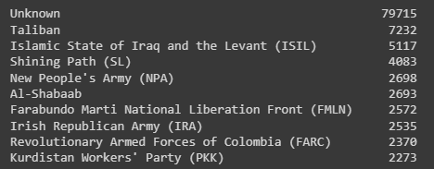
Terrorist Groups
Most of the groups were unidentified
Taliban is in fact contributing to the more Attacks

Slide 17
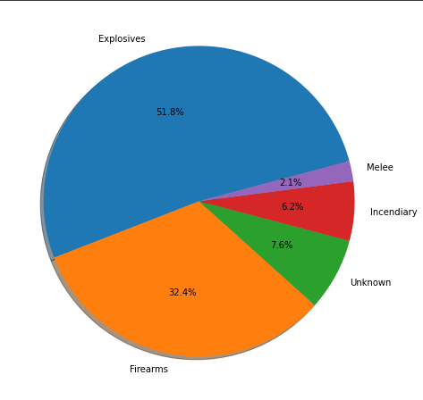
Weapon Types
As we seen in Attack types, Terrorist groups preferred ‘Explosives’ as a weapon in most of the time

Slide 18
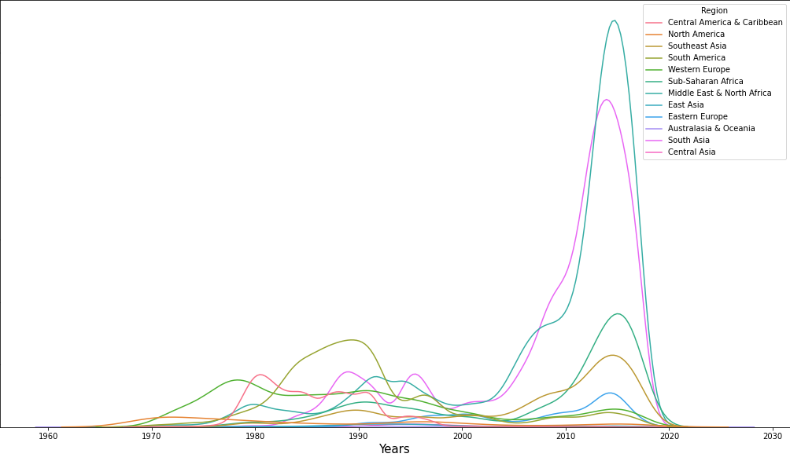
Before & After War(2001)
Major Regions seems Suddenly increase in Terror Attacks after United States took strict action against Terrorism in 2001

Slide 19
War Statement
The war on terror is an ongoing international counterterrorism military campaign initiated by the United States following the September 2001 attacks. The targets of the campaign are primarily Islamic terrorist groups, with prominent targets including al-Qaeda and the Islamic State of Iraq and the Levant.
The Same War Took Placed in 2001

Slide 20
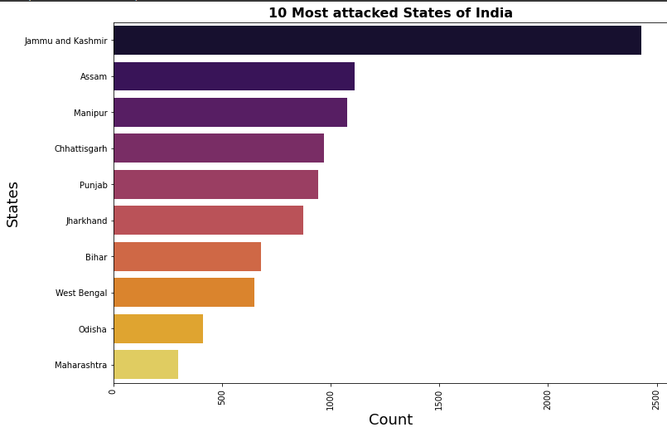
Most Attacked States of India
Jammu & Kashmir suffering most terrorist attacks in India followed by Assam , Manipur because of their Geopolitical locations

Slide 21
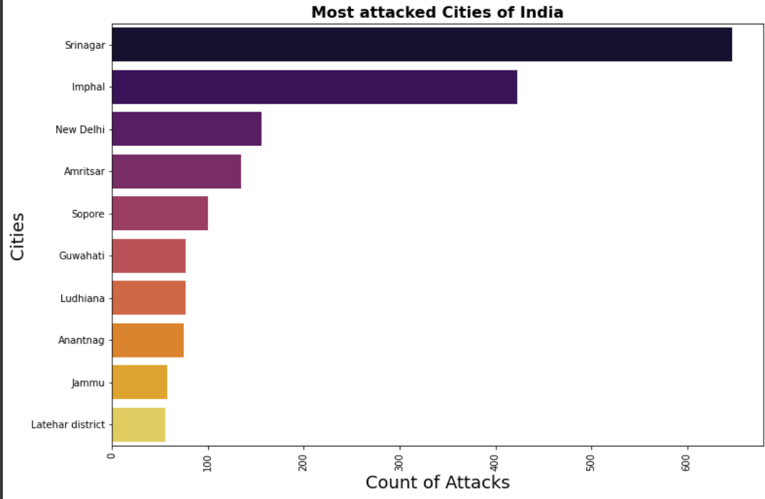
Most Attacked cities of India
In Jammu & Kashmir state , Srinagar is the city which at most affected by Terror Attacks.

Slide 22
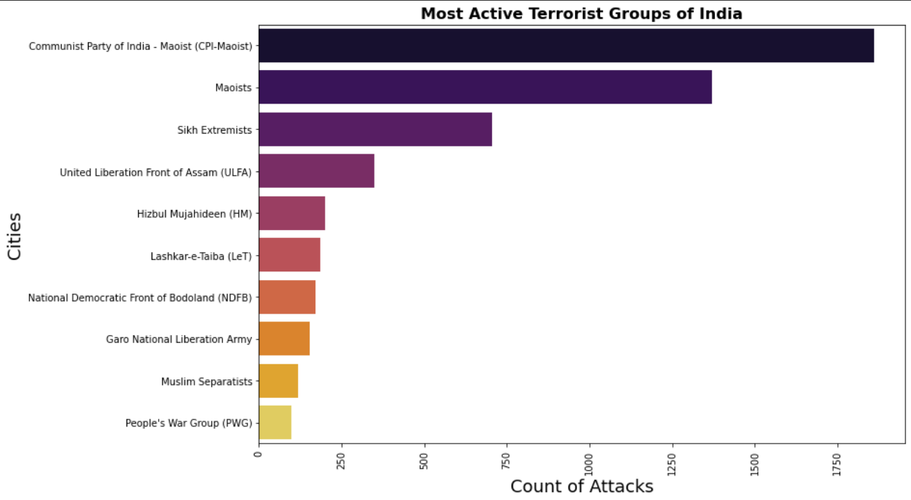
Active groups of India
Communist party of India and Maoist were seen Active during 1970 to 2017.
Let's see about them ,

Slide 23
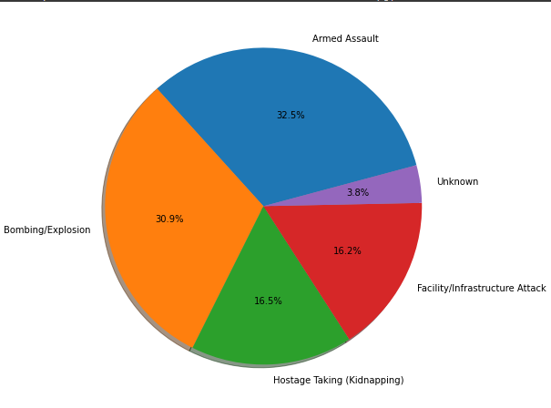

Communist Party of India-Maoist
Cpi-Maoist mostly attacks using Armed Assault and Bombing/Explosion.
Jharkhand , Bihar , Chhattisgarh are their prime locations of Attacks

Slide 24
Challenges faced
As this was our first project at AlmaBetter , Team Building was a bit difficult.
Sharing and Implementing Accepted thoughts , Ideas were bit confusing.
Gaining meaningful Insights from Data set as it was not a cleaned data.
Technical difficulties such as Conceptualizing Data Visualization methods.

Slide 25
Iraq and Pakistan suffered the most terror attacks during 1970 to 2017. Baghdad located in Iraq has the most kills and count of attacks . Middle East & North Africa is the Region that has the maximum number of attacks in the world. Year 2014 has recorded the utmost number of attacks near 16000 worldwide but , major increase in attacks was from 2011 to 2012 i.e., 39%. Countries like Gambia, North Ireland were able to tackle most of the attacks successfully. 88.5% of attacks were successful from terrorist side. Terrorist groups preferring Bombing and armed assault while attacking targeting Private citizens & property and military throughout the years. Major Regions seems Suddenly increase in Terror Attacks after United States took strict action against Terrorism in 2001
Conclusion

Slide 26
Jammu & Kashmir is the most attacked State of India in which Srinagar has the most of the attacks carried out by terrorists and their groups. Communist party of India and Maoist were seen Active during 1970 to 2017. Cpi-Maoist mostly attacks using Armed Assault and Bombing/Explosion. Jharkhand , Bihar , Chhattisgarh are their prime locations of Attacks
End note -India

Slide 27
Thank You !!

